Slide 1

Analyzing Reliance Jio’s Impact on Network Security and Digital Inclusion for Populations Below Poverty Line in India
Team : Rahul Ankoshkar Rohan Reddy Jakkam Pavan Vishnu Sai Bestha
Notes:
Welcome everyone. Today, we will explore Analyzing Reliance Jio’s Impact on Network Security and Digital Inclusion for Populations Below Poverty Line in India. Our team, Myself Rohan Reddy , Rahul, Pavan has conducted a comprehensive analysis to understand these dynamics."

Slide 2
Introduction
Reliance Jio disrupted Indian telecom with affordable data plans
Introduced in 2016, offering highly affordable internet access
Enabled digital inclusion for marginalized populations
Democratized internet connectivity for economically disadvantaged
Empowered rural and urban poor with access to digital services
Rapid expansion exposed network security vulnerabilities
The massive scale of digital adoption revealed security risks
Reports of increased cybersecurity incidents post-Jio
Notes:
SO what is JIO? , Jio is a revolutionary telecom company owned by Mukesh Dhirubhai Ambhani and was launched in 2016 by offering affordable internet services. This initiative has significantly enhanced digital accessibility for the economically disadvantaged, empowering both rural and urban communities. However, this rapid expansion has also introduced several network security and digital inclusivity challenges for economically disadvantaged, which our study aims to address.

Slide 3
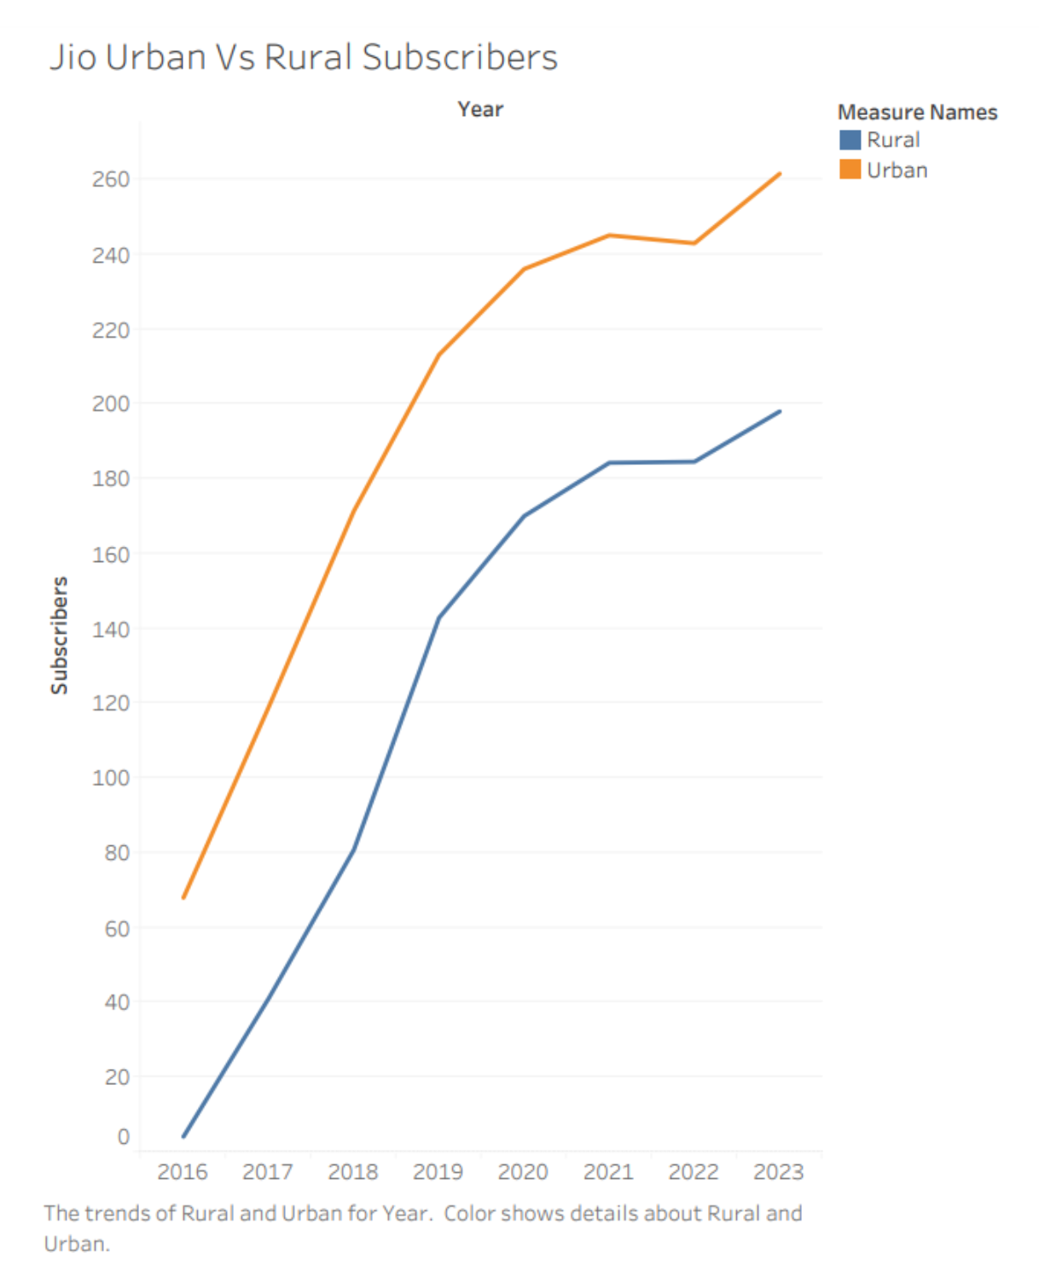

Motivation and Background
⁠Motivation: Reliance Jio's affordable data plans have democratized internet access in India, enabling digital inclusion for economically marginalized populations.
⁠However, this rapid expansion has introduced network security challenges.
⁠Our research aims to understand the intertwined effects of digital inclusion and security vulnerabilities facilitated by Jio's services.
Various studies and reports that provide context and insights relevant to the research on Reliance Jio's impact on network security and digital inclusion in India. These include TRAI reports on telecom subscriber data, market disruption and customer satisfaction studies, research on telecom service quality, and analyses of Jio's pre-launch offer and early adoption.
The above line graph compares Jio’s urban and rural subscribers showing a similar rise in both, rural subscribers catching up.
Notes:
In exploring Reliance Jio’s transformative impact, we find affordable data has democratized internet access, fostering inclusion for marginalized Indians. Our background analysis draws on varied studies, including TRAI data, highlighting Jio's influence on market dynamics and consumer satisfaction. However, this rapid digital expansion raises complex network security challenges. Our research delves into these intertwined facets of digital inclusivity and vulnerability, seeking a deeper understanding of Jio's catalytic role and the broader cybersecurity implications in an increasingly connected India. The line graph here illustrates the narrowing gap between urban and rural subscribers, signalling Jio's pivotal role in digital inclusivity

Slide 4
Methodology
⁠Mixed-methods approach
Comprehensive literature review
Data analysis (TRAI reports, surveys, public data)
Statistical models (linear regression, time series analysis)
⁠Proxy for BPL populations: Rural subscriber data as a representation of individuals below the poverty line.
⁠Visual aids: Graphs and charts to illustrate trends in subscriber growth and network performance
Data Acquisition
- TRAI reports
- Data surveys
- Public datasets
Data Integration and cleaning
- Standardize data formats
- Handle missing data
Preliminary Data Analysis
-Descriptive stats
- Initial insights
Advanced Statistical Analysis
-Difference-in-Differences
- Regression Models
Model Refinement and validation
- Update models based on data trends
Final Analysis & Report Preparation
- Compile findings
- Finalize report
- Prepare presentations
Notes:
We adopted a mixed-methods approach involving an extensive literature review and data analysis, including TRAI reports and customer surveys. Our methodology also involved statistical modeling to quantify the impact, focusing on rural subscribers as a proxy for the Below Poverty Line population."

Slide 5
Hypothesis Testing for Digital inclusivity:
- H0: No significant increase in Jio's rural subscribers (2016-2022)
H1: Significant increase in Jio's rural subscribers (2016-2022)

Slide 6
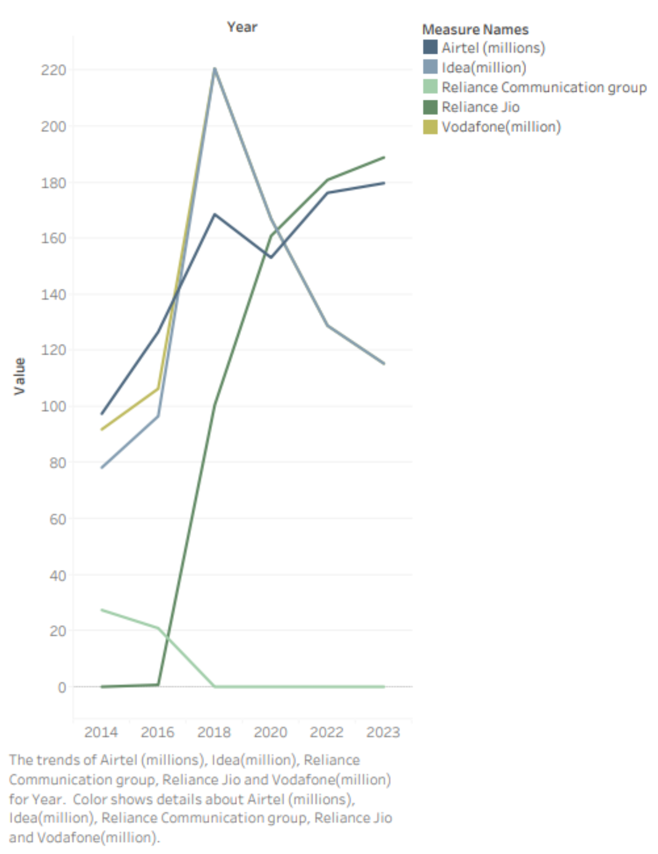
Results
Rural Subscriber Growth Analysis: After evaluation we rejected the Null-Hypothesis(H0) and accepted Alternative-Hypothesis(H1) that Reliance Jio had a positive impact on subscriber growth, indicating digital inclusivity.
Test Conclusion: Significant increase in Jio's rural subscribers from inception until 2022, supporting increased digital inclusivity.
The line graph should depict the evolution of Jio's rural subscriber base over time, with the x-axis representing the years since Jio's launch and the y-axis showing the number of rural subscribers.
Linear Regression Analysis:
P-value: 0.002 (Reject null hypothesis)
Slope: 24.04 (Significant yearly increase)
Notes:
For this hypothesis testing we have conducted a linear regression analysis which reveals a statistically significant increase in Jio's rural subscriber base, with a p-value of 0.002 and a slope of 24.04, clearly indicating Jio's expansive role in driving digital inclusivity since its launch. After evaluation we rejected the Null-Hypothesis(H0) and accepted Alternative-Hypothesis(H1) that Reliance Jio had a positive impact on subscriber growth, indicating digital inclusivity. This a line graph demonstrating the growth in rural subscribers over the years, clearly illustrating Jio's pivotal role in expanding digital access.

Slide 7
Hypothesis Testing for network vulnerability
Null Hypothesis (H0): The introduction of Reliance Jio has not led to an increase in network security incidents.
Alternative Hypothesis (H1): The introduction of Reliance Jio has led to an increase in network security incidents.

Slide 8
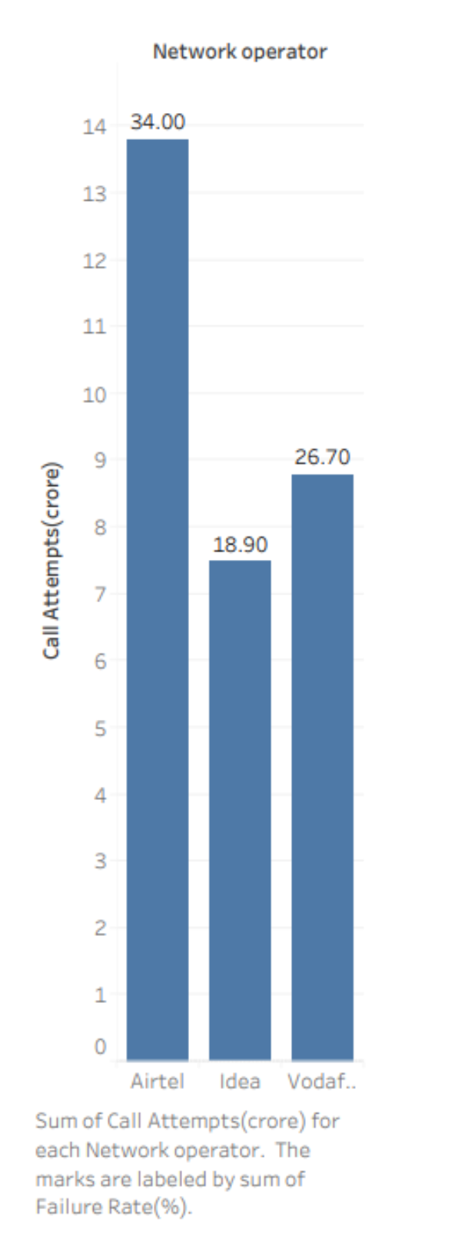
Results
This bar chart depicts the voice call failures from Jio service to various services.
The lack of inter-telecom connections shows the gap in the network security of Jio.
Making it an inconvenience for all groups of people including BPL
Airtel has the highest call failure rate at 34%.
Vodafone has a failure rate of 26.7%.
Idea has the lowest at 18.9%.
We have rejected the Null-Hypothesis after Evaluating voice call failures and performing descriptive analysis.
We have also looked at various articles online, citing them and found out other security incidents. Occurring in various districts like Dharampuri, Bangalore, and Bhopal.
Notes:
Turning our attention to the results of our analysis, the bar chart displayed here offers a stark visualization of voice call failures from Jio to other network operators. This highlights a critical gap in Jio's network security, impacting various user groups including those below the poverty line. Airtel tops the chart with a 34% failure rate, followed by Vodafone at 26.7%, while Idea has the lowest at 19.8%. These figures led us to reject the null hypothesis, affirming significant network challenges. Further investigation into various districts like Dharampuri, Bangalore, and Bhopal reveals a broader spectrum of security incidents, underscoring the need for heightened cybersecurity measures.

Slide 9
Further analysis For final SUbmission
Economic Impact:
* Null Hypothesis (H0): Reliance Jio’s low-cost data plans have not had a significant economic impact on individuals below the poverty line.
* Alternative Hypothesis (H1): Reliance Jio’s low-cost data plans have had a significant eco- nomic impact on individuals below the poverty line, contributing to increased employment or entrepreneurial activities.
Educational Access:
* Null Hypothesis (H0): There has been no significant improvement in educational access through digital platforms for students below the poverty line following the introduction of Reliance Jio.
* Alternative Hypothesis (H1): There has been a significant improvement in educational access through digital platforms for students below the poverty line following the introduction of Reliance Jio.
Notes:
In our final submission, we dissect two critical areas: Jio's economic and educational impact. We challenge the notion that Jio's low-cost plans haven't significantly helped those below the poverty line, hypothesizing marked economic and educational benefits instead. Our analysis aims to confirm whether Jio has indeed spurred employment and improved educational access, reshaping India's socio-economic landscape for the better.

Slide 10

Take ways:
Keep in mind we have made assumptions for the BPL group.
Digital Inclusion: We've witnessed a marked upsurge in internet accessibility in rural areas, where traditionally, such connectivity has been a challenge.
Economic Empowerment: Affordable connectivity has not only opened doors to new economic avenues but has also enhanced access to education, integrating a wider community into the burgeoning digital economy.
Security Concerns: The rapid digital expansion, though beneficial, has brought to the fore significant security vulnerabilities. There's an imperative need for reinforced protective measures to safeguard this newfound connectivity.
Regulatory Needs: Our findings underscore the need for robust regulatory frameworks. These frameworks must protect equitable access while considering the unique needs and literacy levels of the BPL group.
Future Focus: We advocate for relentless vigilance in security practice adaptations, striving to harmonize the pace of digital growth with the safeguarding of user safety.
Notes:
In reflecting on our research, it's pivotal to note the assumptions made for the BPL community. We've observed significant advancements in digital access across rural regions, enabling socio-economic upliftment through affordable connectivity. However, with these strides in digital inclusion come heightened security vulnerabilities. Thus, it is crucial to advocate for reinforced security measures and the development of regulatory frameworks that address the specific needs of the BPL population. As we progress, continuous vigilance in security practices is essential to safeguard this digital momentum

Slide 11

Thank You

